Slide 1
Fundamentals of Algorithm (FA)
Omkar Basnet
Academic Incharge , CSIT/BCA
Texas international college

Slide 2
Revision of chapter 1:
Before getting into chapter two lets do something
Calculate the Tilde approximation and order of growth of following complexity function
3n+8
Tilde approximation : 3n , order of growth : O(n)
n² +2
n⁴ +100 n + 50
2n³+ 2n²
Log n + 5n ²
nlogn+ 87

Slide 3
Chapter two (3 teaching hours)
Model of computation
Introduction and types

Slide 4
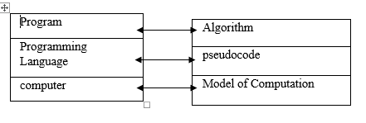
Model of Computation
Computation model or model of computation is a mathematical model in computational science that requires extensive computational resource to study the behavior of complex system by computer simulation (virtually).

Slide 5
Model of Computation
RAM (Random access Machine) Model :
In this model , the basic operation such as +, -, *, etc. takes unit or constant time i.e. 1.
Loops and subroutines (if……else) are not basic operations.(i.e. we cannot guarantee that the complexity is constant or simply one.)
Each memory reference is one step.
We measure runtime of algorithm by counting the total steps.

Slide 6
Model of Computation
RAM (Random access Machine) Model :
For example:
Print (“ Enter the any number”) // basic statement takes unit time === 1
Scanf(%d, a) // basic statement takes unit time === 1
Print(“enter another number ”) // basic statement takes unit time === 1
Int sum = a+b // basic statement takes unit time == 1
Print (value of sum) //basic statement takes unit time === 1
Time Complexity= O(1) constant order of growth

Slide 7
Model of Computation
RAM (Random access Machine) Model :
For example:
For (i=1; i <=n ; i++) // not a basic statement(executes n times)
{
m=m+2 // basic statement constant time (unit) or lets say c
}
Time complexity = c * n = O(n)
In case of if… else the only statement is executed(either if or else) so time complexity will be addition of condition and the statement of executed block.

Slide 8
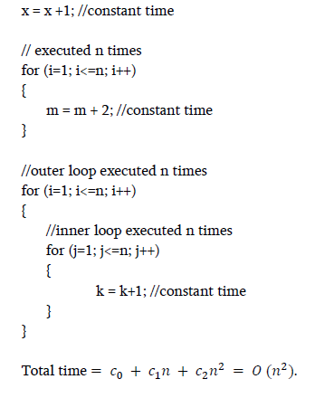
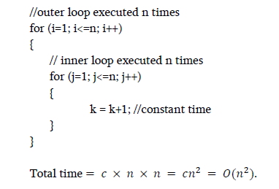
Model of Computation
RAM (Random access Machine) Model :
For example:

Slide 9
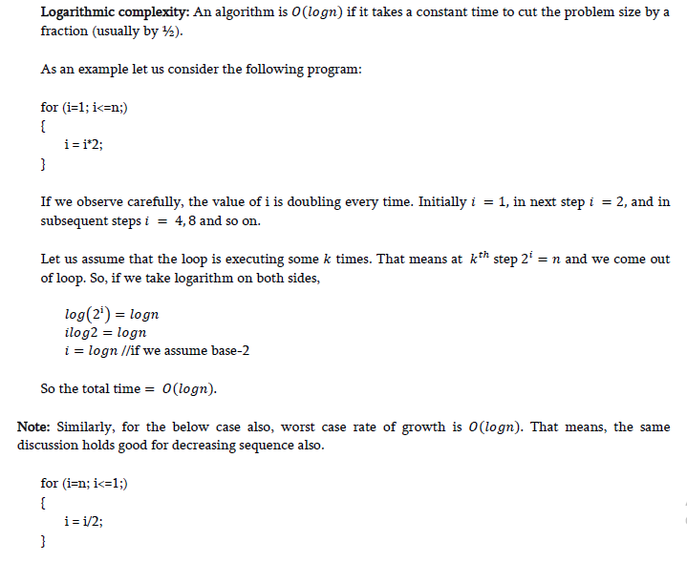

Slide 10
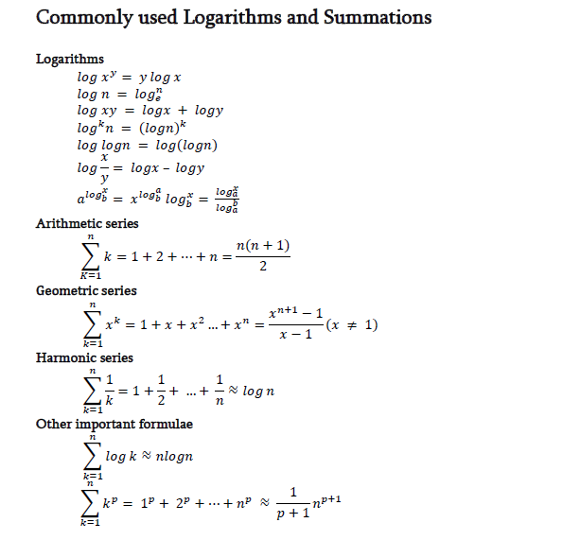

Slide 11
Model of Computation
Some other model of computation are:
In most of the cases we use RAM model to analysis the algorithm. Some other computational models are as follows:
Logical circuit(Boolean Algebra)
Finite state machine: automata theory , where computational steps are represented as nodes.
Turing machine
Push down finite automata etc.

Slide 12
LETS SEE YOU ON NEXT CHAPTER ||

